Slide 1

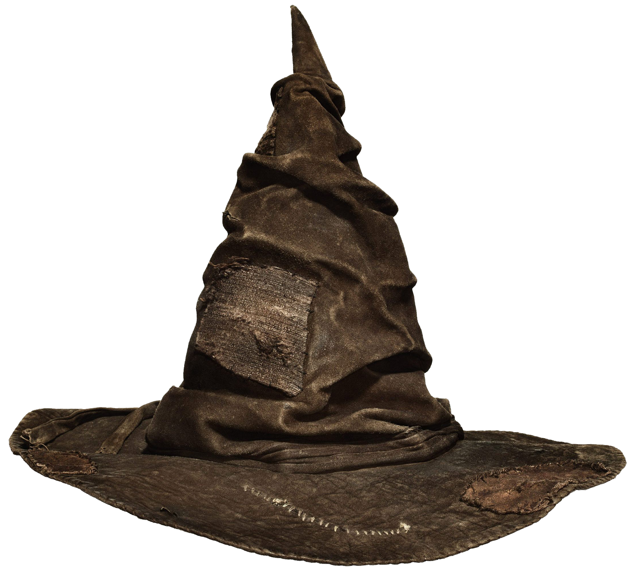
Machine Learning

Slide 2












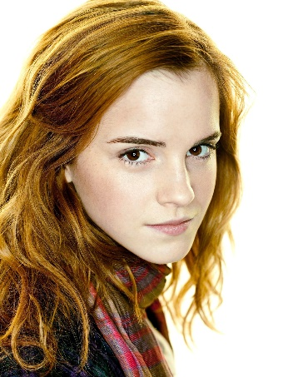
a.k.a. Train
Classify
Notes:
I learn from previous students so I can sort future students
What I learn is what distinguishes each house

Slide 3


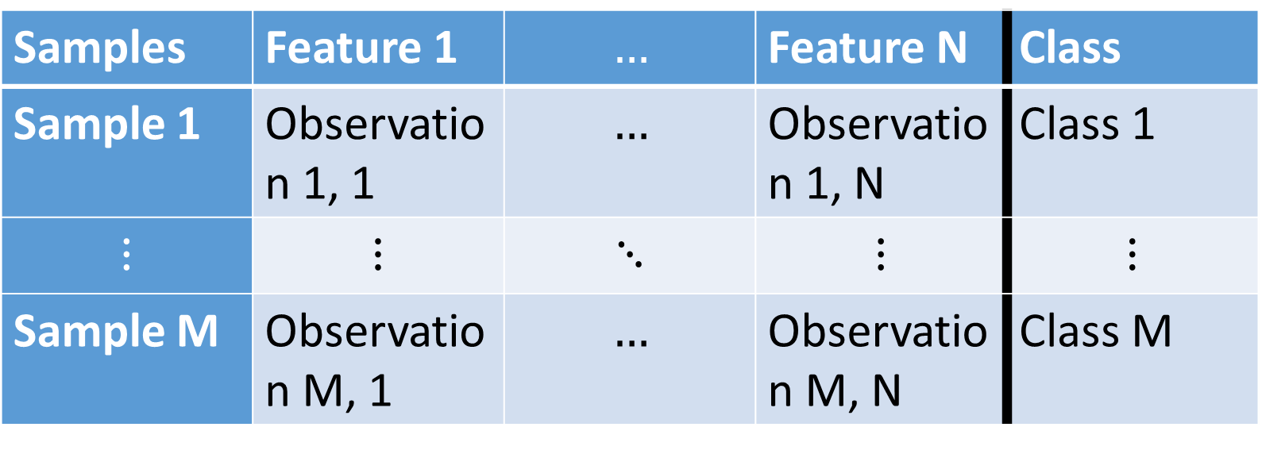
Data
Samples | Feature 1 | $$…$$ | Feature N | Class
Sample 1 | Observation 1, 1 | $$…$$ | Observation 1, N | Class 1
$$⋮$$ | $$⋮$$ | $$⋱$$ | $$⋮$$ | $$⋮$$
Sample M | Observation M, 1 | $$…$$ | Observation M, N | Class M

Slide 4

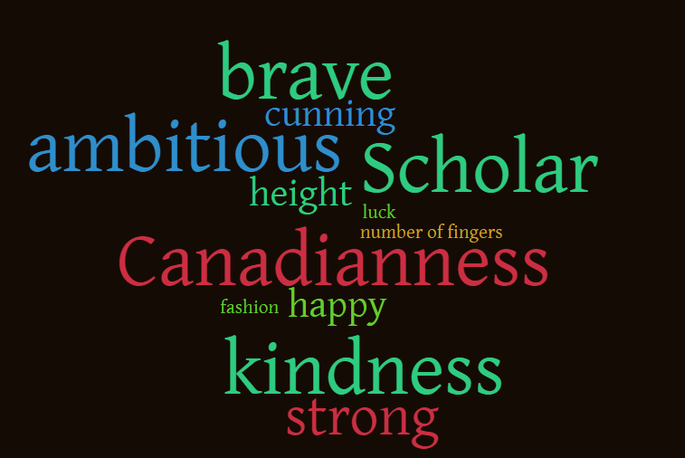
Features
Notes:
I gathered some data from 80 previous students to learn from
Some of them help distinguish classes, others not so much

Slide 5
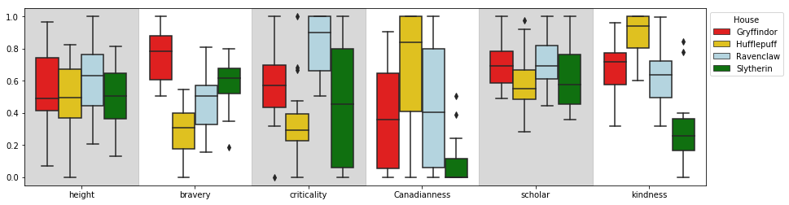
Features from 80 Hogwarts students

Slide 6
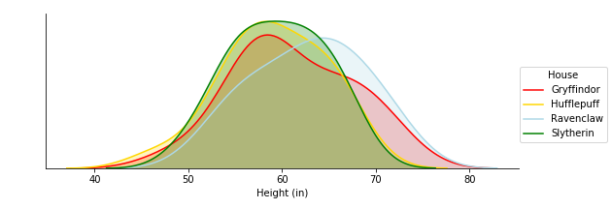
Height does not separate Houses
Notes:
Height is super easy to measure!
It does not separate clearly by house :/

Slide 7
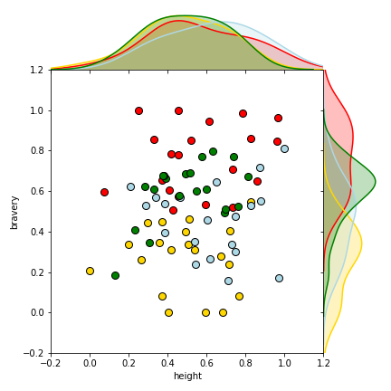
Interaction between bravery and height is dominated by effects of bravery
Notes:
What does the interaction tell us?

Slide 8
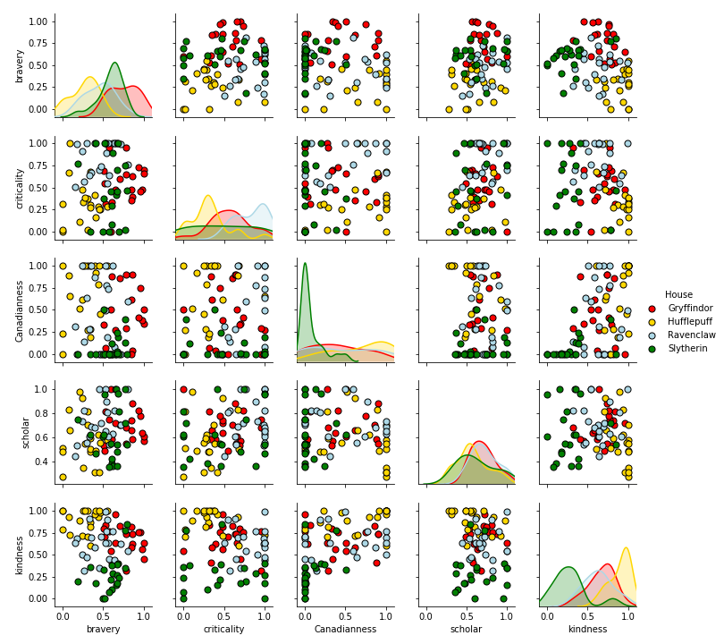
More pairwise comparisons of interactions!
Let’s not draw more lines though…

Slide 9
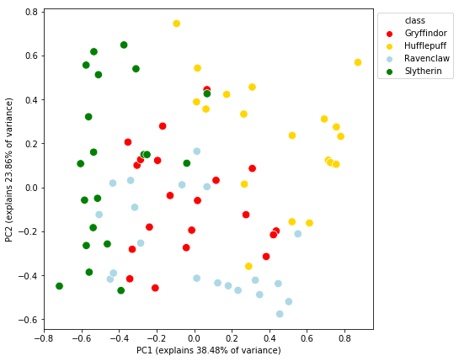
You mere muggles can only view things in up to two dimensions
Notes:
PCA is data scaled by the first two eigenvectors of the covariance matrix, duh
More simply, it is a projection of our 6 dimensional data into 2d space that preserves the variance between samples

